Slide 1
Machine learning: simulation and data
Rafael Coelho Lopes de Sa
HSF India Training event - Bhubaneswar
December 21st, 2023

Slide 2
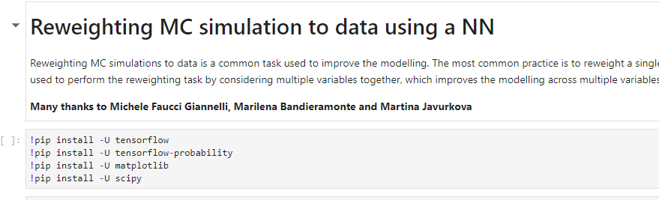
Before we start
Go to my binder: https://binderhub.ssl-hep.org/v2/gh/rafaellopesdesa/hsfindia-generative/HEADgpu_false
Go to the reweighting exercise and run the pip command.
Let it run while I talk about what we will do…
Run this cell and let’s talk about physics while it installs

Slide 3
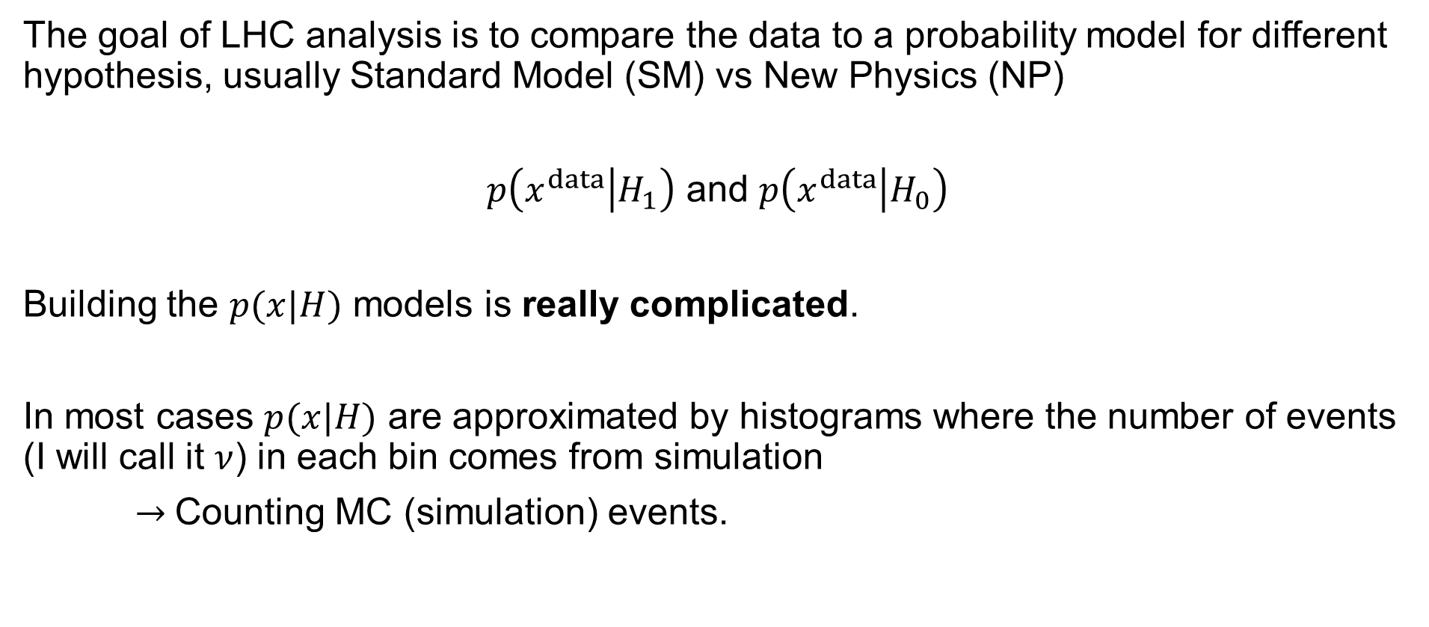
Analysis and simulation
The goal of LHC analysis is to compare the data to a probability model for different hypothesis, usually Standard Model (SM) vs New Physics (NP)
$p\left(x^{data} | H_{1}\right)$ and $p\left(x^{data} | H_{0}\right)$
Building the $p(x|H)$ models is really complicated.
In most cases $p(x|H)$ are approximated by histograms where the number of events (I will call it $ν$) in each bin comes from simulation
$→$Counting MC (simulation) events.

Slide 4
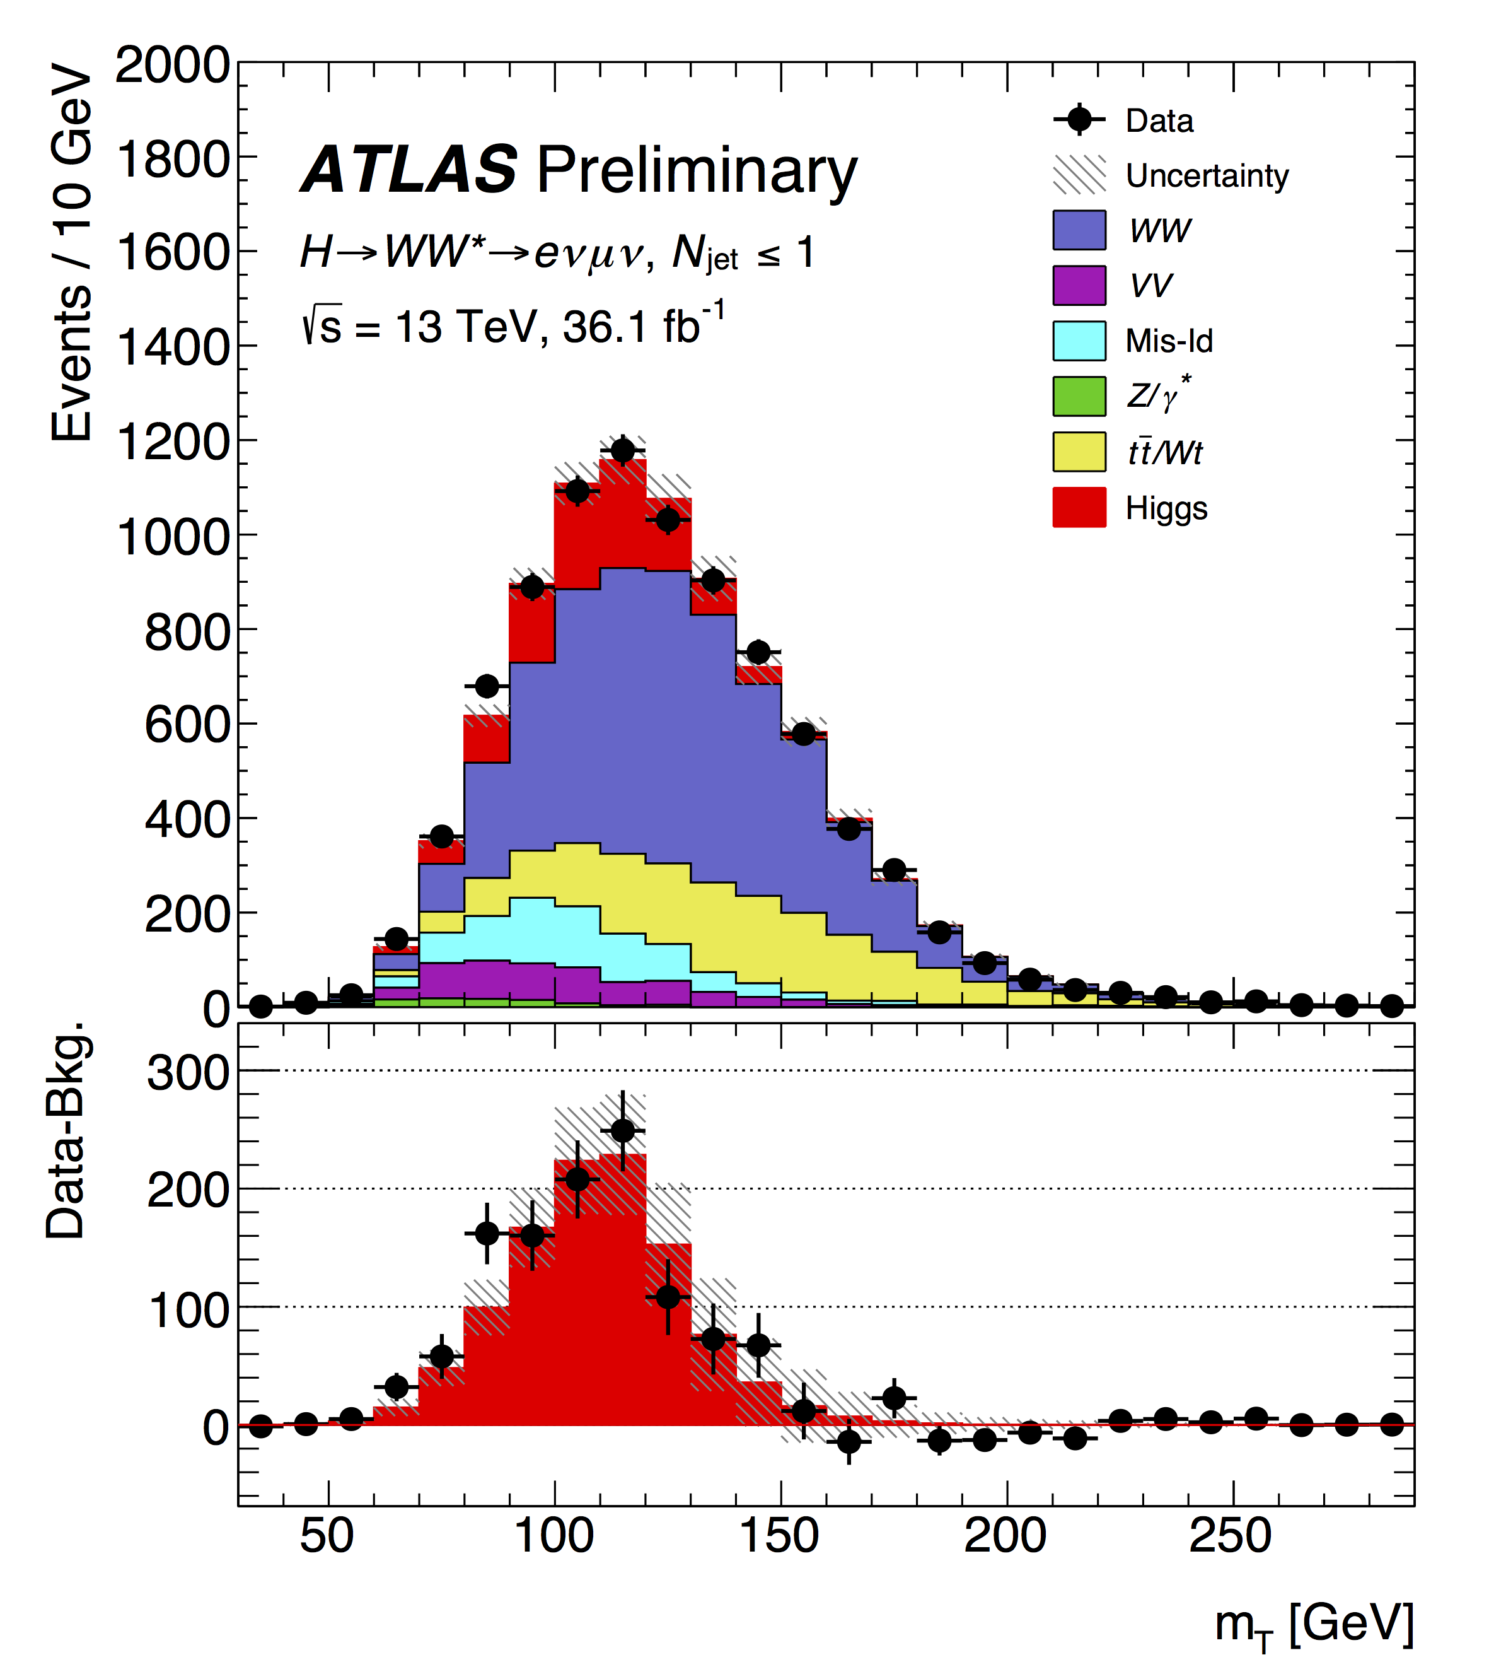
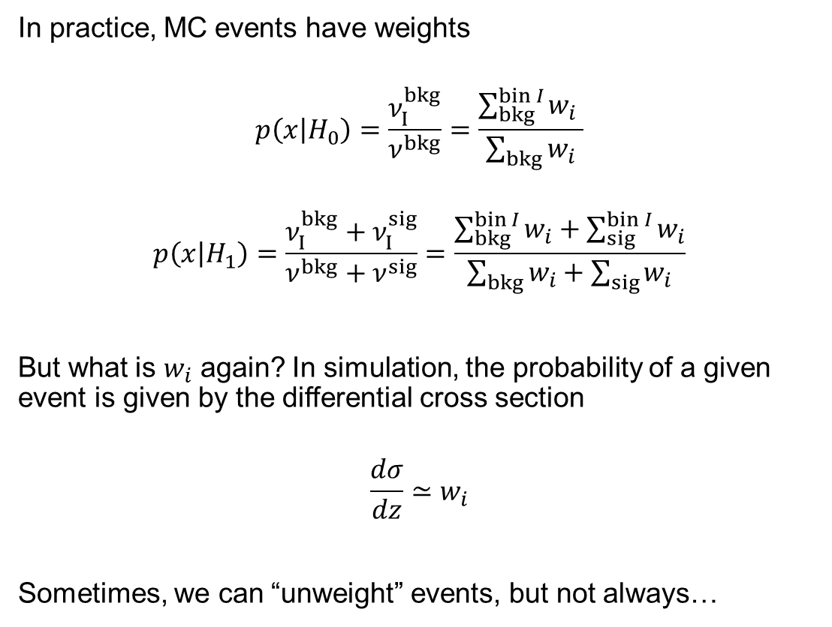
How do we count MC events?
In practice, MC events have weights
$$p\left(x | H_{0}\right)=\frac{ν_{I}^{bkg}}{ν^{bkg}}=\frac{\sum_{bkg}^{bin I}{w_{i}} }{\sum_{bkg}{w_{i}}}$$
$$p\left(x | H_{1}\right)=\frac{ν_{I}^{bkg}+ν_{I}^{sig}}{ν^{bkg}+ν^{sig}}=\frac{\sum_{bkg}^{bin I}{w_{i}}+\sum_{sig}^{bin I}{w_{i}}}{\sum_{bkg}{w_{i}}+\sum_{sig}{w_{i}}}$$
But what is $w_{i}$ again? In simulation, the probability of a given event is given by the differential cross section
$$\frac{dσ}{dz}≃w_{i}$$
Sometimes, we can “unweight” events, but not always…

Slide 5
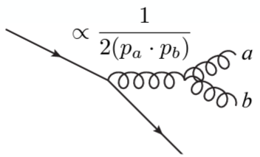
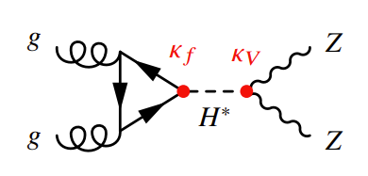
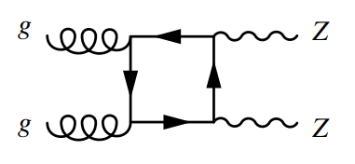
Negative weights
Cross sections are all positive. So why do we have negative weights?
Perturbation theory, parton shower, and interference
Higher order terms have divergencies
A common way to remove these divergences is to introduce negative weights.
In addition, the same kind of emission can be introduced by parton showers. Negative weights are a common way to remove double counting.
Processes with interference can be funny…
This is positive, but the interference term can be positive or negative
2
+
*
2Re

Slide 6
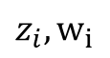
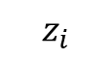
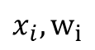
So, what’s the idea?
Sample a phase space point just constrained by conservation of energy-momentum
Generator
Simulator
$$z_{i}$$
$$z_{i},w_{i}$$
$$x_{i},w_{i}$$

Slide 7
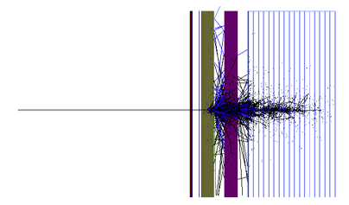
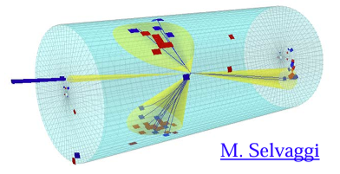
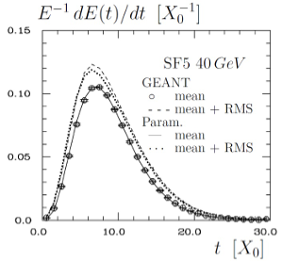
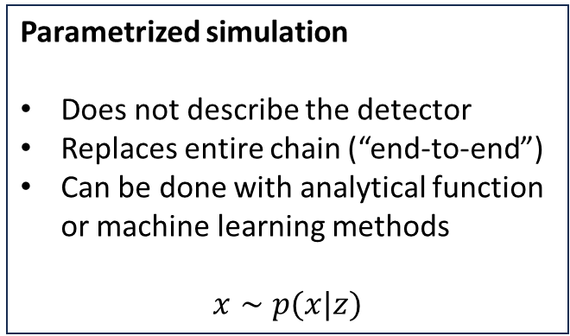
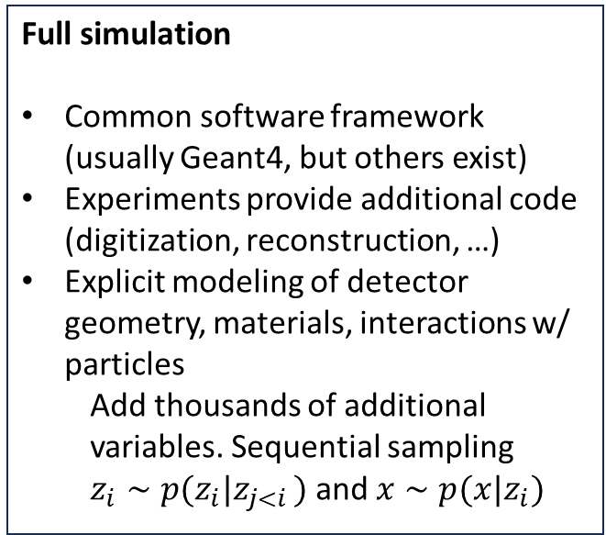
Simulation
Fast simulation
Usually experiment-specific framework
Explicit modeling of detector geometry
Add approximations: analytical shower shapes, truth-associated track reconstruction, …
Full simulation
Common software framework (usually Geant4, but others exist)
Experiments provide additional code (digitization, reconstruction, …)
Explicit modeling of detector geometry, materials, interactions w/ particles
Add thousands of additional variables. Sequential sampling
$z_{i}∼p(z_{i}|z_{j<i })$ and $x∼p(x|z_{i})$
Parametrized simulation
Does not describe the detector
Replaces entire chain (“end-to-end”)
Can be done with analytical function or machine learning methods
$$x∼p(x|z)$$

Slide 8
Simulation landscape
How can we use ML with simulation?
Augment the full simulation
Improve the MC weights with data
Calibrate your simulation
Replace (part of) full simulation
Create an “end-to-end” parametrized simulation
Goals:
Increase speed while preserving accuracy
Preserve speed while increasing accuracy
Our need
Accuracy
FullSim
Geant4
Machine Learning
FastSim
Parameterized simulation
Speed

Slide 9
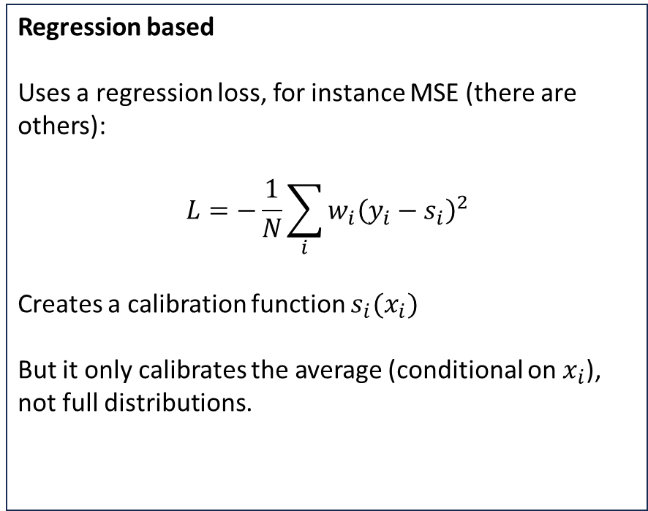
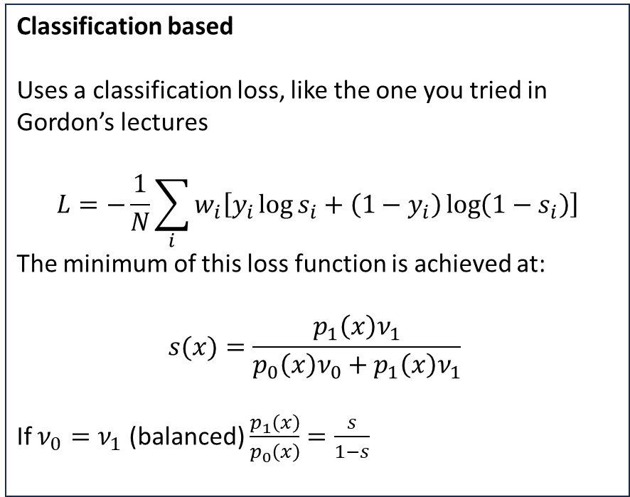
Augment full simulation
Usually deterministic.
Classification based
Uses a classification loss, like the one you tried in Gordon’s lectures
$$L=−\frac{1}{N}\sum_{i}{w_{i}\left[y_{i}\log{s_{i}}+\left(1−y_{i}\right)\log\left(1−s_{i}\right)\right]}$$
The minimum of this loss function is achieved at:
$$s(x)=\frac{p_{1}\left(x\right)ν_{1}}{p_{0}\left(x\right)ν_{0}+p_{1}\left(x\right)ν_{1}}$$
If $ν_{0}=ν_{1}$ (balanced) $\frac{p_{1}\left(x\right)}{p_{0}\left(x\right)}=\frac{s}{1−s}$
Regression based
Uses a regression loss, for instance MSE (there are others):
$$L=−\frac{1}{N}\sum_{i}{w_{i}{\left(y_{i}−s_{i}\right)}^{2}}$$
Creates a calibration function $s_{i}(x_{i})$
But it only calibrates the average (conditional on $x_{i}$), not full distributions.

Slide 10
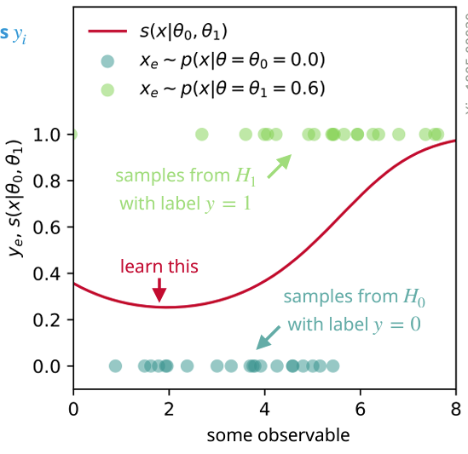
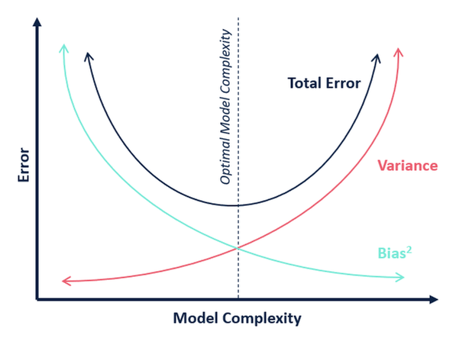
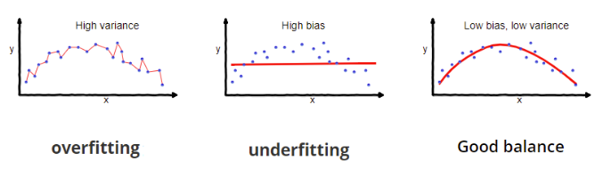
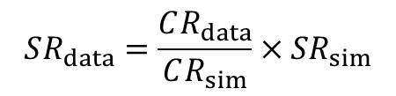
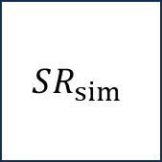



Classification-based reweighting
Relies on finding a control region (CR).
Reweight between CR and SR need to be validated carefully.
Try the activity in binder!
https://binderhub.ssl-hep.org/v2/gh/rafaellopesdesa/hsfindia-generative/HEADgpu_false
$$SR_{data}=\frac{CR_{data}}{CR_{sim}}×SR_{sim}$$
$$CR_{data}$$
$$SR_{data}$$
$$CR_{sim}$$
$$SR_{sim}$$

Slide 11
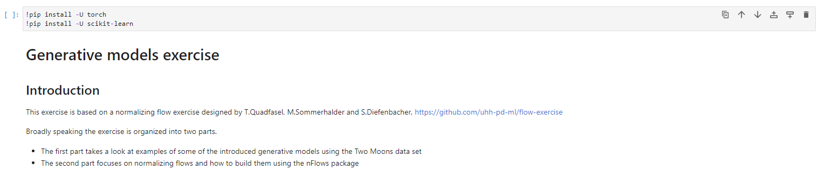
Intermezzo
Now let’s do the second part…
Go to the generative directory in binder and run the pip cell (it assumes you are using the same session as the reweight one)

Slide 12
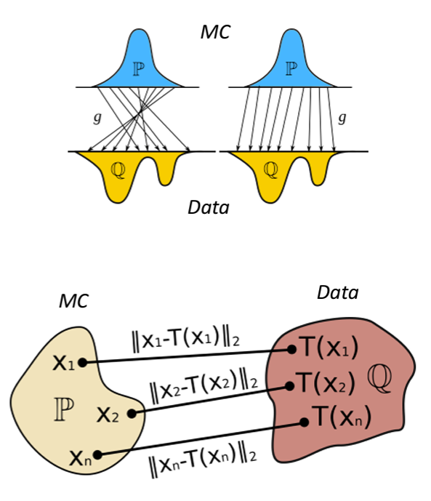
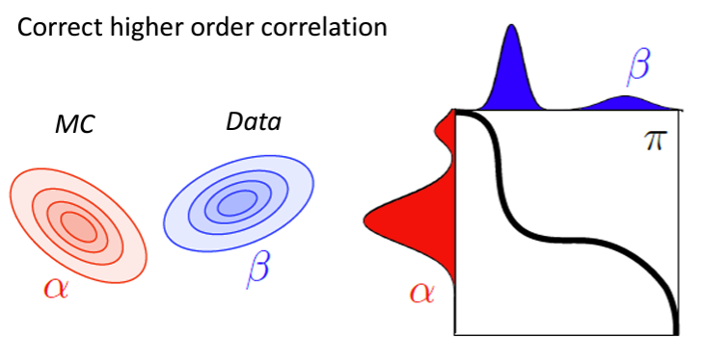
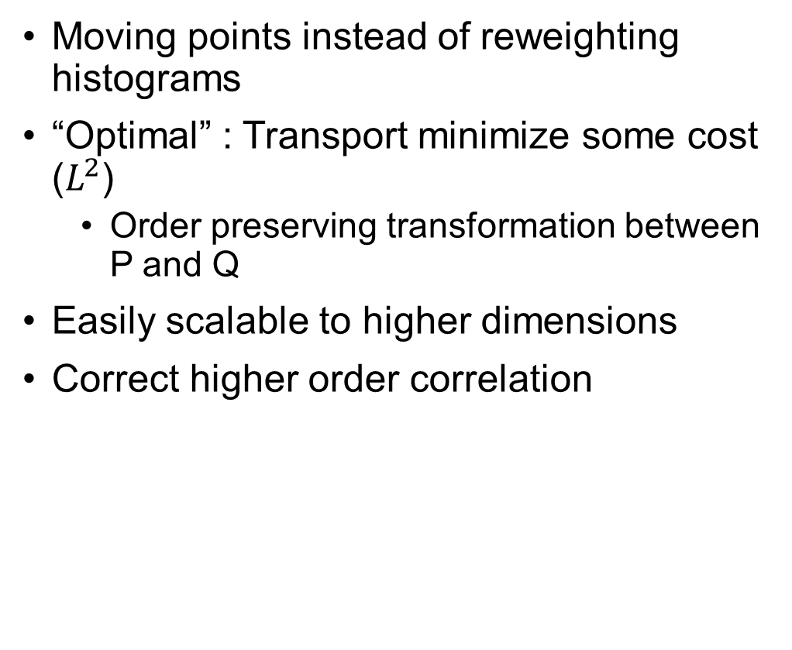
Optimal transport
Moving points instead of reweighting histograms
“Optimal” : Transport minimize some cost ($L^{2}$)
Order preserving transformation between P and Q
Easily scalable to higher dimensions
Correct higher order correlation

Slide 13
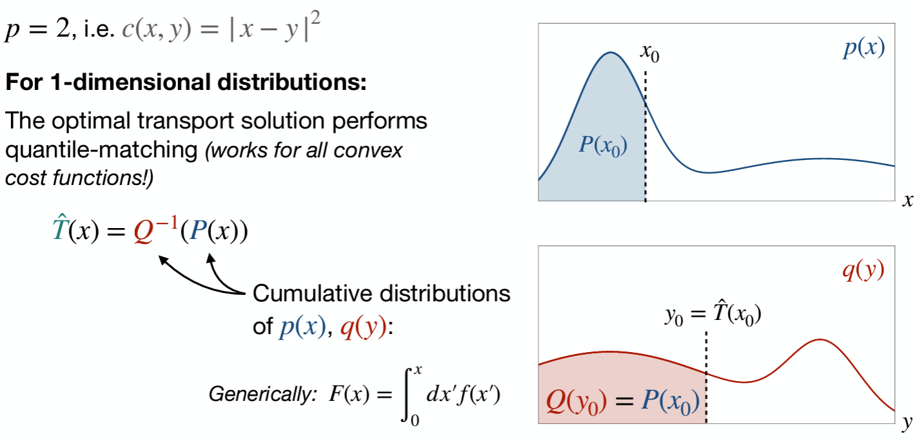
1D optimal transport

Slide 14
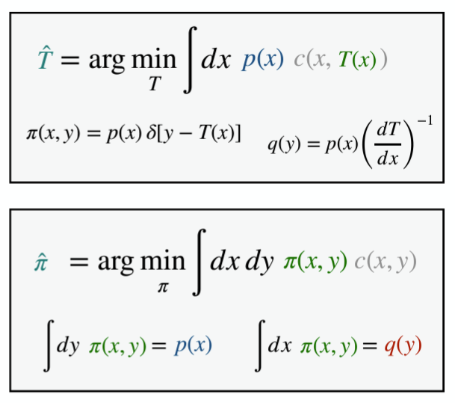
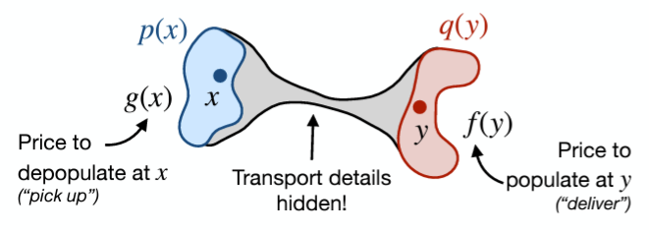
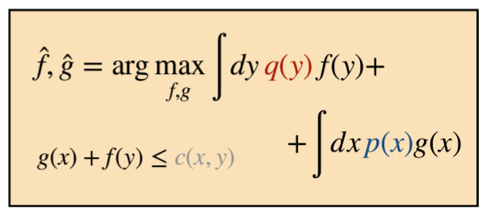
ML optimal transport
Idea: Why not move the simulation instead of reweighting it?
Optimal Transport
Continuous calibration without histograms
Easily scales to higher dimensions and cheap
Integral of sample unchanged

Slide 15
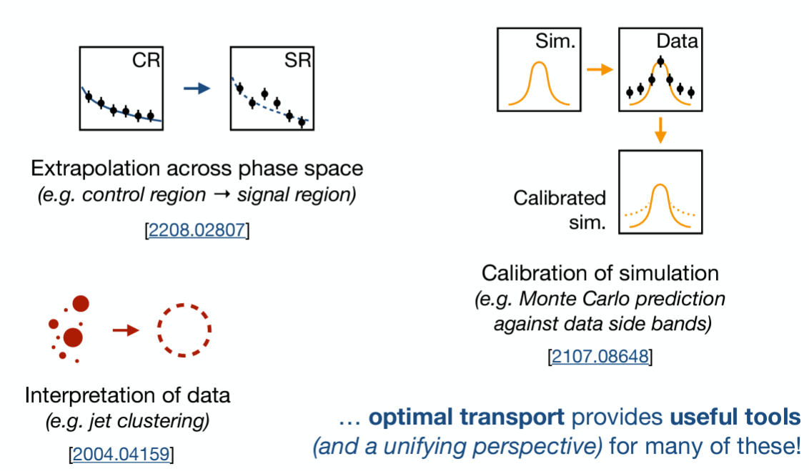
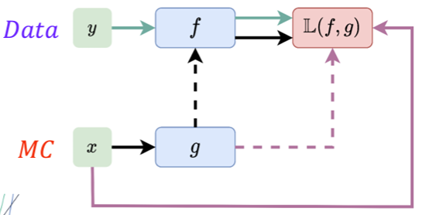
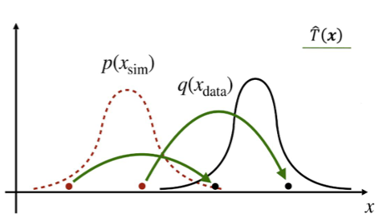
Optimal transport
Very recently, a solution on how to train multi-dimensional OT with ML has been found.
Brand new area of ML that is just now finding applications

Slide 16
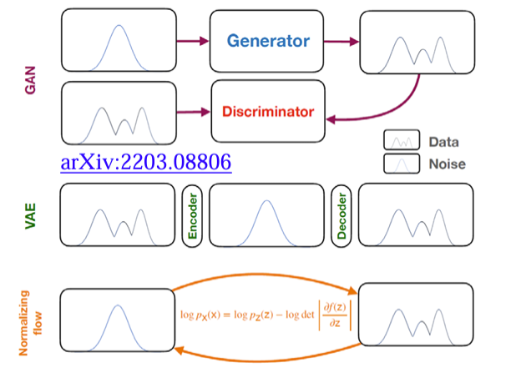
Generative methods
Generative models (“replace”):
Usually stochastic
Generative Adversarial Networks (GANs)
Variational Autoencoders(VAEs)
Normalizing Flows (NFs)

Slide 17
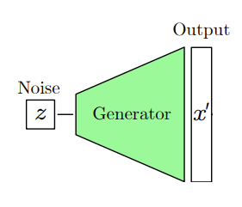
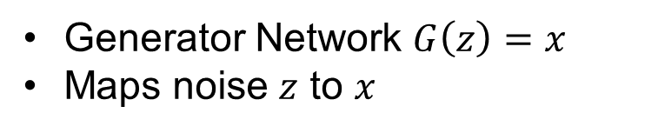
Generative Adversarial Network
Generator Network $G\left(z\right)=x$
Maps noise $z$ to $x$

Slide 18
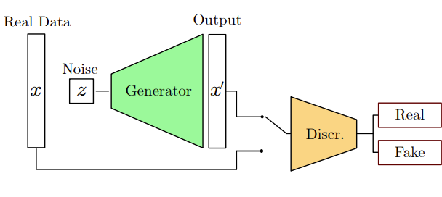
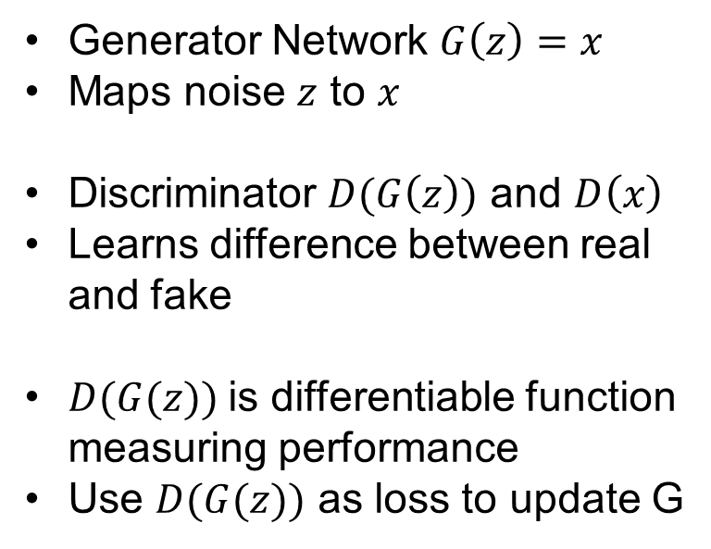
Generative Adversarial Network
Generator Network $G\left(z\right)=x$
Maps noise $z$ to $x$
Discriminator $D(G\left(z\right))$ and $D\left(x\right)$
Learns difference between real and fake
$D(G(z))$is differentiable function measuring performance
Use $D(G(z))$ as loss to update G

Slide 19
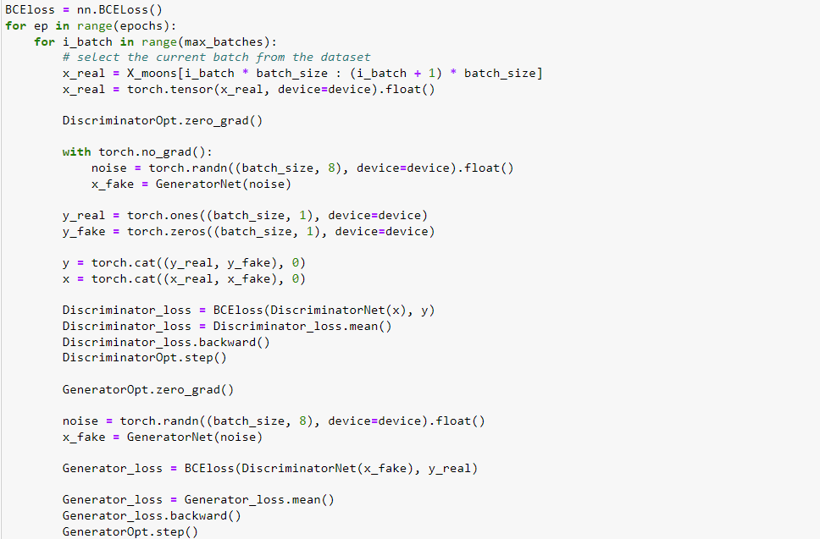
Generative Adversarial Network

Slide 20
Generative Adversarial Network
Upsides
Intuitive approach
Easy to introduce additional constraints
Well explored with several improvements (WGANs, normalizations)
Downsides
Difficult to train
Gen. and disc. needs to be balanced
Can fail to converge
Prone to mode collapse

Slide 21
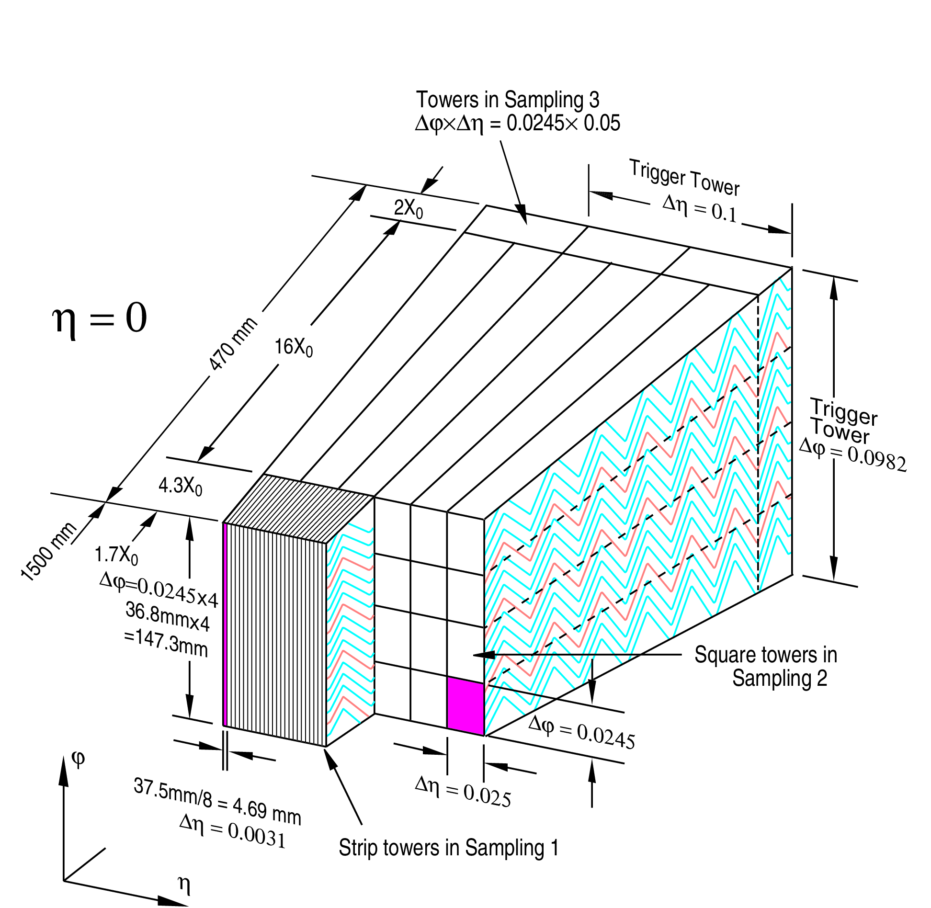
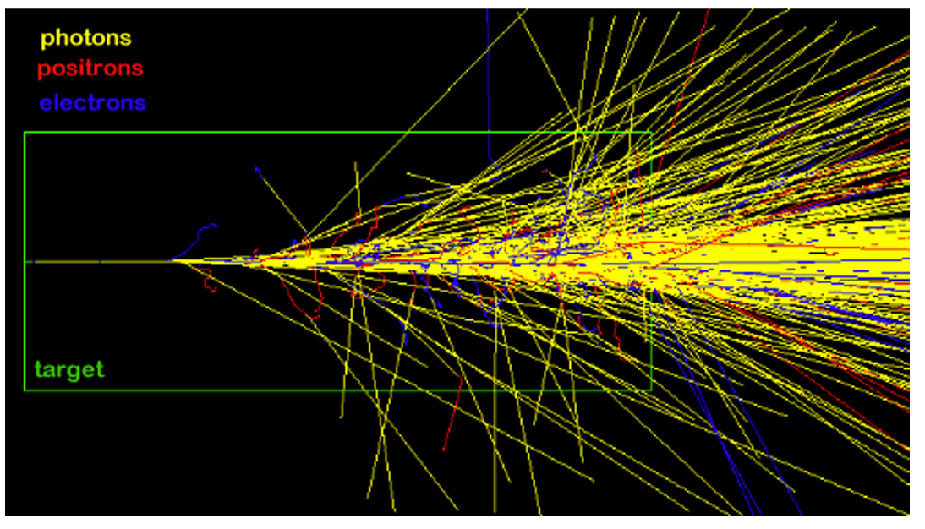
Simulation of showers in ATLAS calorimeter

Slide 22
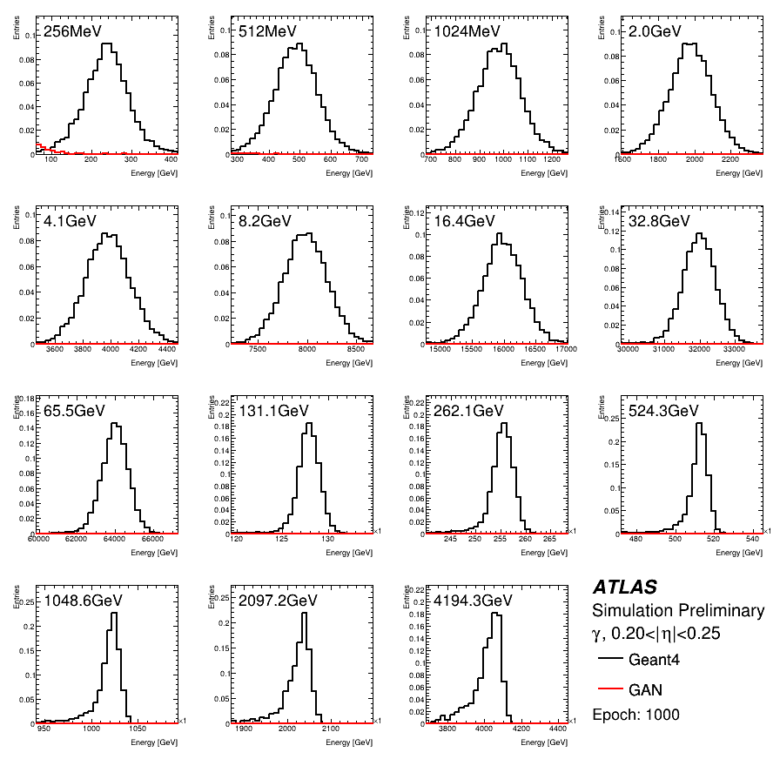
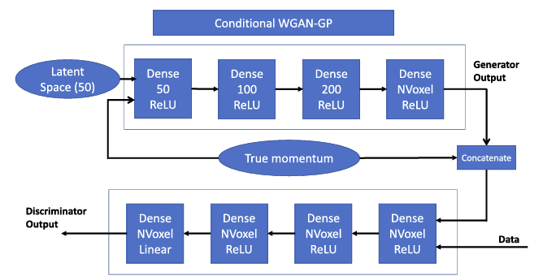
Simulation of showers in ATLAS calorimeter
FastCaloGAN V2
Different GAN for different type of particles and for different eta slices.
Prediction of deposit of energy in “voxels” which allow HITS reconstruction.

Slide 23
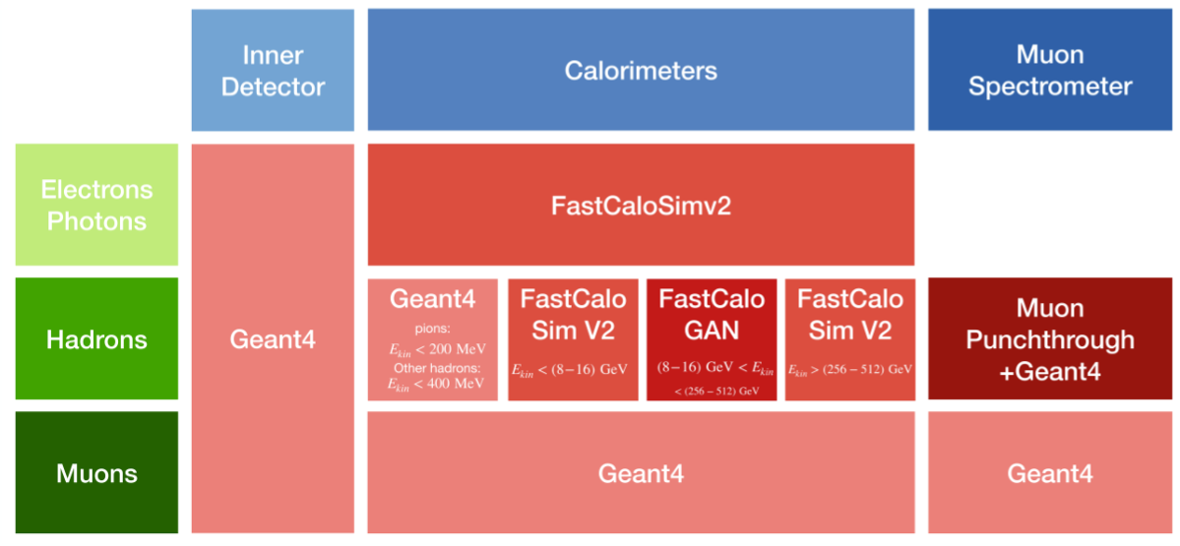
How do we use this in a fast MC?

Slide 24
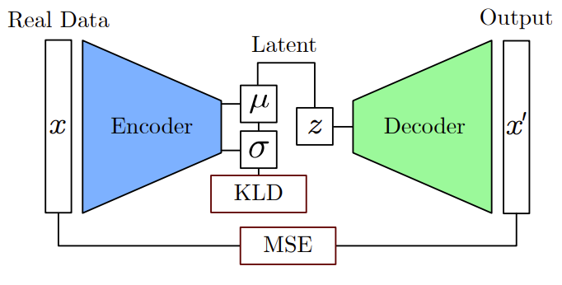
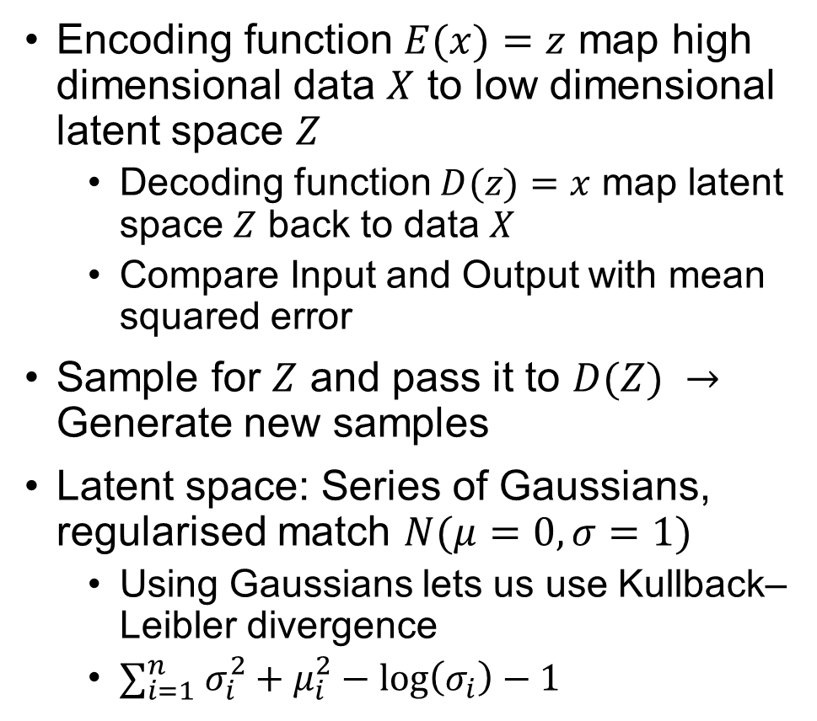
Variational AutoEncoders (VAE)
Encoding function $E(x)=z$ map high dimensional data $X$ to low dimensional latent space $Z$
Decoding function $D(z)=x$ map latent space $Z$ back to data $X$
Compare Input and Output with mean squared error
Sample for $Z$ and pass it to $D(Z) →$ Generate new samples
Latent space: Series of Gaussians, regularised match $N(μ=0, σ=1)$
Using Gaussians lets us use Kullback–Leibler divergence
$∑_{i=1}^{n} σ_{i}^{2}+μ_{i}^{2}−\log\left(σ_{i}\right)−1$

Slide 25
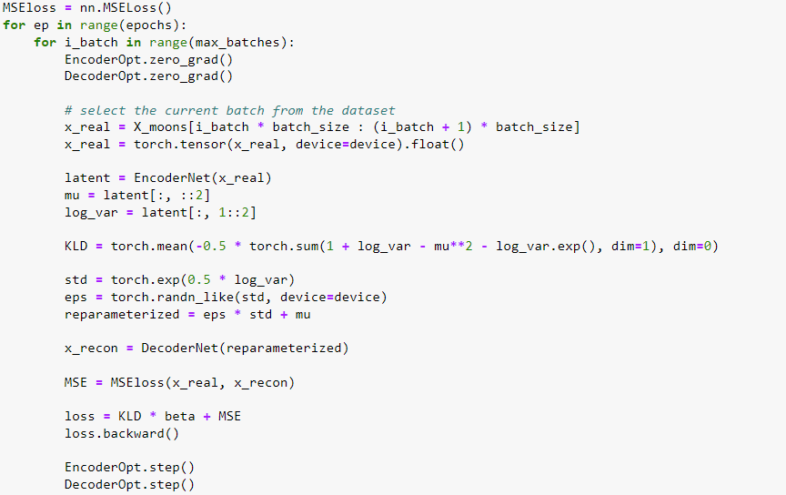
Training Variation AutoEncoders

Slide 26
Variational AutoEncoders
Upsides
Directly evaluates log likelihood
Stable in training
Downsides
MSE loss insufficient for certain data sets
Needs to balance KLD and MSE loss terms

Slide 27
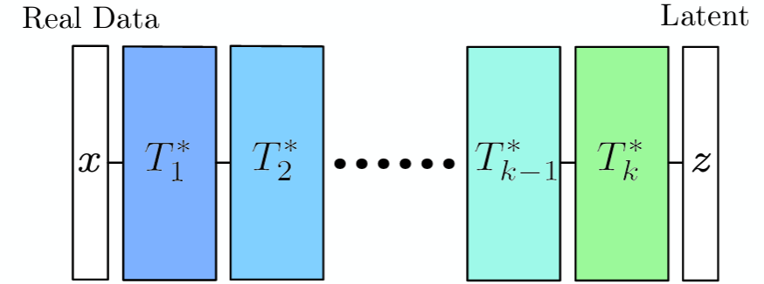
Normalizing flows
Variational AutoEncoder: map data to normal distribution and back using two networks
Can we do this with a single network instead?

Slide 28
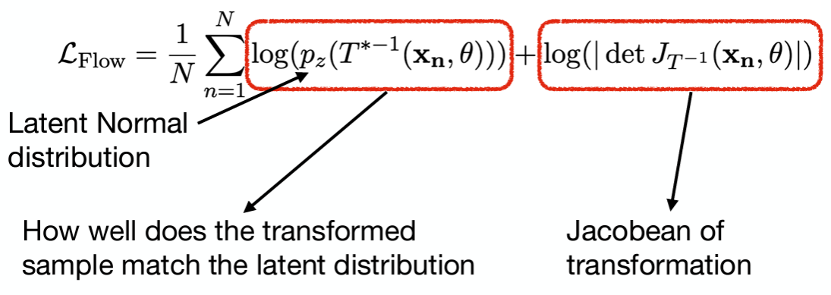
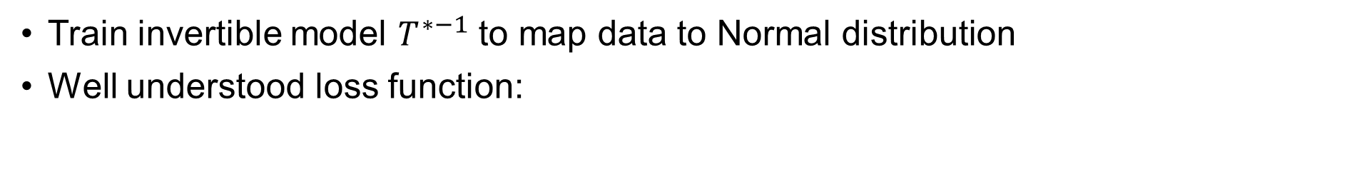
Normalizing flows
Train invertible model $T^{∗−1}$ to map data to Normal distribution
Well understood loss function:

Slide 29

Normalizing flows

Slide 30
Normalizing Flows
Upsides
Directly evaluates log likelihood
Stable in training
High generative quality
Easy to train and use
Downsides
Fixed dimensionality through entire flow
Slow generation times for large models/data

Slide 31


How do we use this?
Normalizing flow to predict high-level analysis quantities from generator-level information
Reproduces correlations even in ML b-tagging algorithm scores
Very promising solution for end-stage analyses
Effectively infinite MC → minimize statistical fluctuations

Slide 32


Simulation-based inference
Remember that in my first slide I said that the purpose of an analysis was to calculate
$p\left(x^{data} | H_{1}\right)$ and $p\left(x^{data} | H_{0}\right)$
The methods presented here allows us to approximate these probabilities densities with much more precision than simple histograms

